Slide 1
An introduction to confidential computing
Fabien Petitcolas
Smals Research

Slide 2

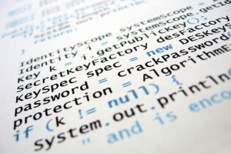



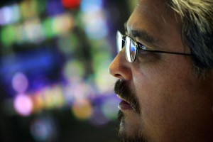
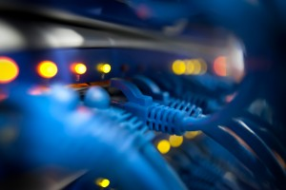
Smals – Support for e-Government
Support for e-government
Knowhow
Development
www.smals.be
Staffing
Infrastructure
Notes:
Smals was set up in 1939 to enable the family allowance funds to use the modern mechanographic systems of the time. In essence, Smals is still pursuing the same mission. Smals' objective is to support its members in information management and related issues, with a view to providing integrated IT services.
Knowhow - Best practice, as well as substantive and technical knowledge, are key success factors for innovation within government
Staffing - Smals makes over 800 specialists available to public services and facilitates collaboration with ICT consultants from the private sector
Development - Smals has been extremely successful in creating customised applications with high-quality and longevity
Infrastructure - A complete design, installation and operational management service, from the provision data centre space to 24x7 monitoring

Slide 3
Agenda
Secure remote computation
Homomorphic encryption
Secure multiparty computation
Trusted execution environments (TEE)
Comparison of maturity
Secured processors for TEE
Conclusions and recommendations

Slide 4

Traditional computation on encrypted data
Computer
hard-drive
Microprocessor
Computer memory
110111
011111
000110
101101
001101
BONJOURVOXXEDDAYSBRUXELLES!
110100
010100
011100
111000
011011
HELLOVOXXEDDAYSBRUSSELS!
Notes:
Image source: https://www.pexels.com/photo/person-using-silver-macbook-pro-1181467/

Slide 5

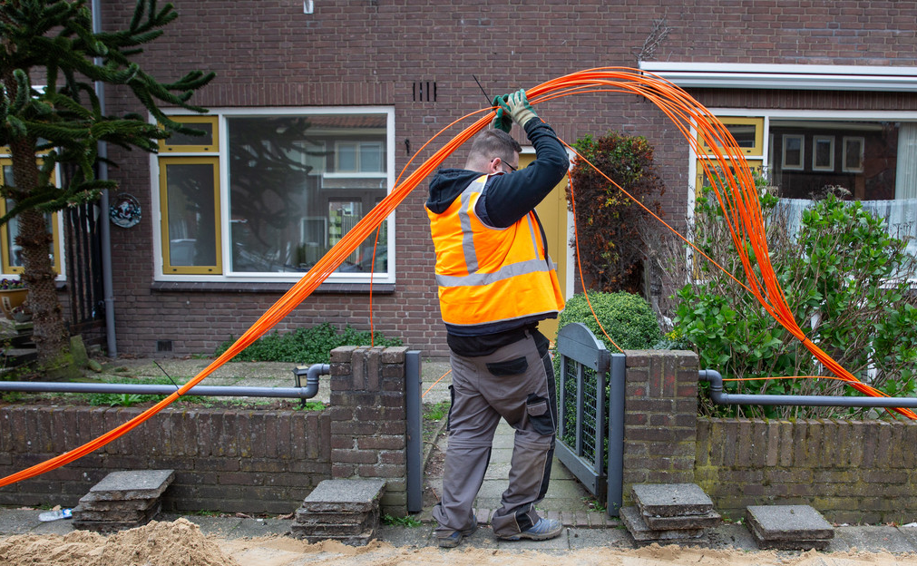
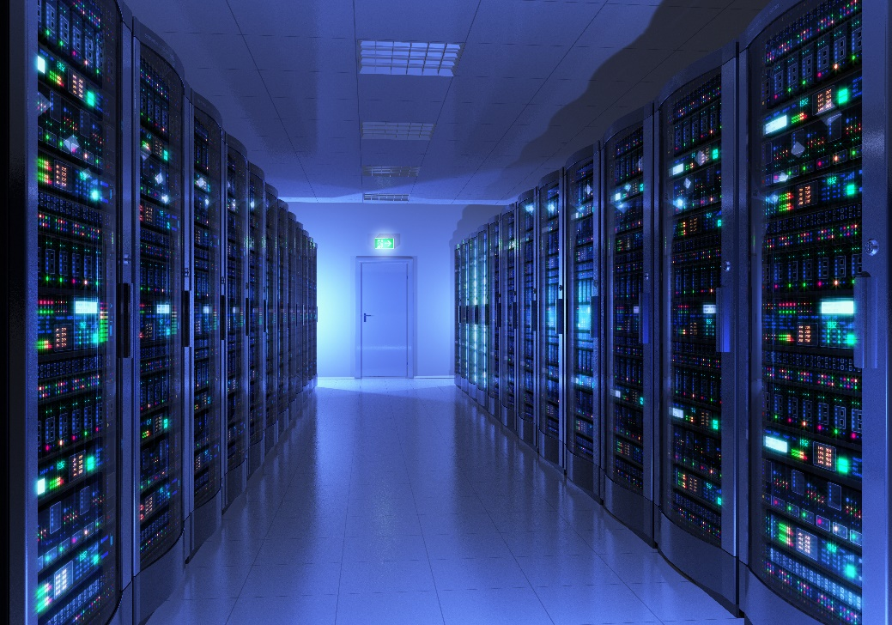
Basic remote computation
Concern: confidentiality, privacy (GDPR), sovereignty, etc. of data “in use”?
Not entirely trusted
Computation request
Client
Shared computing
infrastructure
Results of computation
Computer hard-drive
Microprocessor
Computer memory
110111
011111
000110
101101
001101
BONJOURLASECURITESOCIALEBELGE!
110100
010100
011100
111000
011011
HALLOBELGISCHESOCIALEZEKERHEID
Notes:
Image source: https://www.pexels.com/photo/person-in-white-shirt-using-computer-4709289/

Slide 6
Main techniques for trusted remote computation
Aim: move the infrastructure provider outside of the trust boundary
Compute directly on
encrypted data
Split data and share computation between parties
Compute inside “enclave”
110011
00101
11011
01111
00011
011011001010111
11011
0111100011
11011
00101
00111
00111
Homomorphic encryption (HE)
Secure multiparty computation (MPC)
Trusted execution environments (TEE)

Slide 7
Homomorphic encryption (HE)

Slide 8


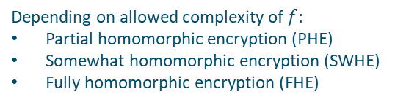
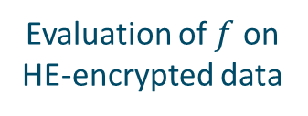

Homomorphic encryption: schematic overview
Client
Shared computing infrastructure
HE-encrypted data
function to evaluate $\left(f\right)$
HE-encrypted results
Evaluation of $f$ on
HE-encrypted data
HE secret key
Depending on allowed complexity of $f$:
Partial homomorphic encryption (PHE)
Somewhat homomorphic encryption (SWHE)
Fully homomorphic encryption (FHE)

Slide 9





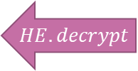




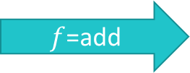




Homomorphic encryption: trivial example
$$7$$
$$105$$
store
$$105$$
$$HE.encrypt$$
$$3$$
$$HE.encrypt$$
$$45$$
$$45$$
$f$=add
$$k=15$$
$$⟦m⟧=HE.encrypt\left(k,m\right):=k⋅m$$
$$HE.add$$
$$10$$
$$HE.decrypt$$
$$150$$
response
$$150$$

Slide 10
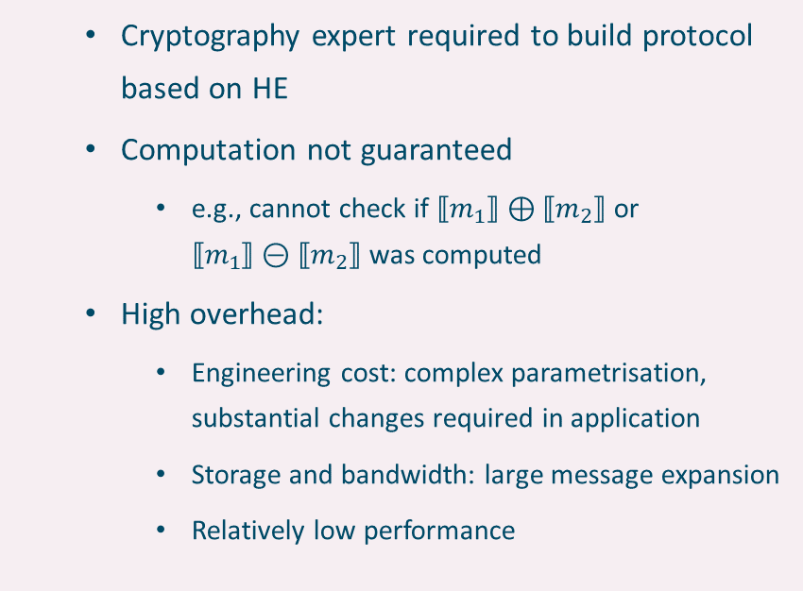
Advantages and limits of homomorphic encryption
Pros
Cons
Compute directly on encrypted data
Security based on strong mathematical evidence under well defined assumptions
Does not need special hardware
Some schemes robust to post-quantum attacks
Active research area
  Cryptography expert required to build protocol based on HE
  Computation not guaranteed
    e.g., cannot check if $⟦m_{1}⟧⊕⟦m_{2}⟧$ or
    $⟦m_{1}⟧⊝⟦m_{2}⟧$ was computed
  High overhead:
    Engineering cost: complex parametrisation, substantial changes required in application
    Storage and bandwidth: large message expansion
    Relatively low performance

Slide 11
Secure multiparty computation (MPC)

Slide 12
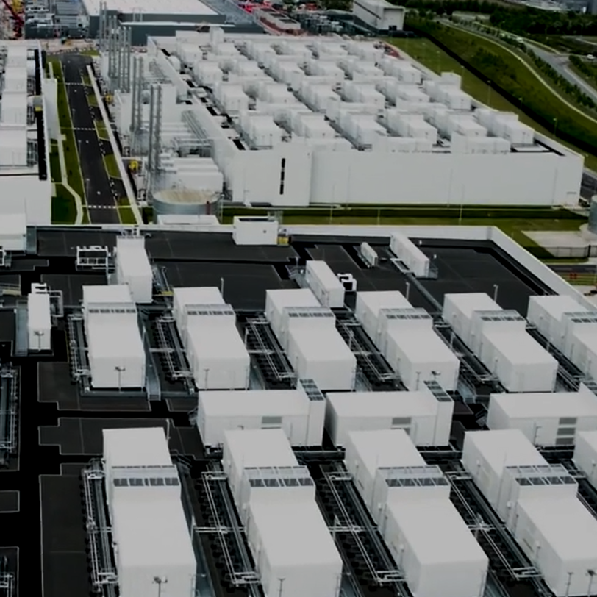
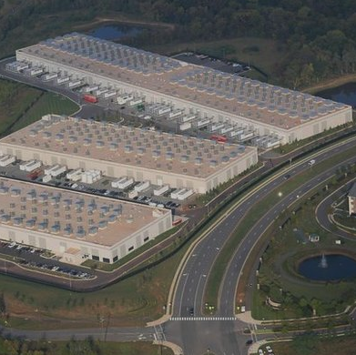


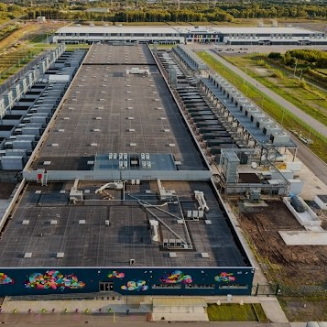
MPC problem example
Three computing companies want to know which one of them has the lowest carbon footprint without revealing their respective values
Solutions:
  Use a trusted party (hard to find)
  Use multiparty computation (MPC): it enables mutually distrusting parties to compute an arbitrary function on their inputs.

Slide 13
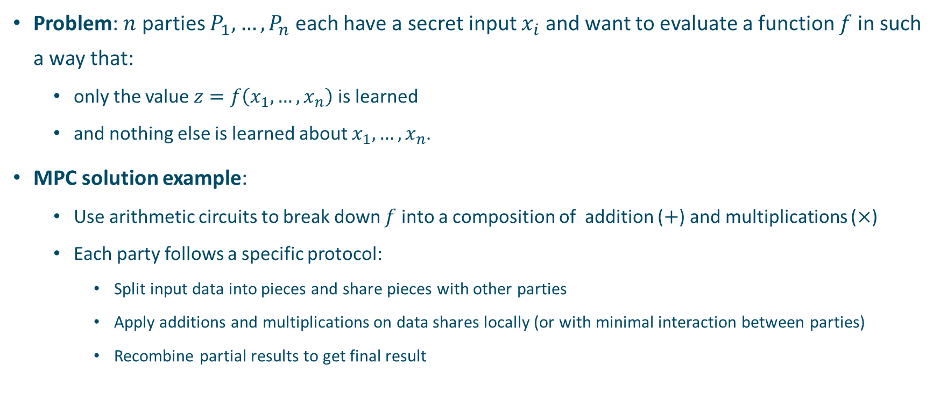
MPC problem and a solution
Problem: $n$ parties $P_{1},…,P_{n}$ each have a secret input $x_{i}$ and want to evaluate a function $f$ in such a way that:
  only the value $z=f\left(x_{1},…,x_{n}\right)$ is learned
  and nothing else is learned about $x_{1},…,x_{n}$.
MPC solution example:
  Use arithmetic circuits to break down $f$ into a composition of addition ($+$) and multiplications ($×$)
  Each party follows a specific protocol:
    Split input data into pieces and share pieces with other parties
    Apply additions and multiplications on data shares locally (or with minimal interaction between parties)
    Recombine partial results to get final result

Slide 14

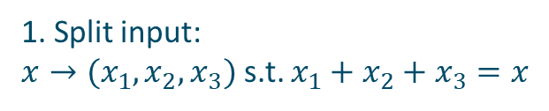


MPC in action: simple addition example
$$P_{2}$$
1. Split input:
$x→(x_{1},x_{2},x_{3})$ s.t. $x_{1}+x_{2}+x_{3}=x$
21
4
+
1
0
3
2. Share input
$$P_{1}$$
2
1
4
2
3
3
3
+
1
4
3. Local addition
7
21
4. Share partial results
2
1
4
+
5. Local addition of final result
2
1
4
6
6
+
6
2
1
4
2
1
4
12
12
12
+
2
1
4
+
3
2
5
21
10
$$P_{3}$$

Slide 15





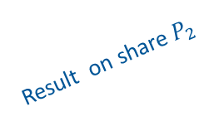



MPC deployment example
Client
Shared computing infrastructures
$$P_{1}$$
Share for $P_{1}$
Result on share $P_{1}$
$$P_{2}$$
Exchange of intermediary results
Share for $P_{2}$
Result on share $P_{2}$
$$P_{3}$$
Share for $P_{3}$
Result on share $P_{3}$
Recombine results

Slide 16
Advantages and limits of MPC
Pros
Cons
Enable collaboration between untrusting parties
Does not require central trusted party
Cryptographic-based security
Does not require special hardware
Active research area
Complexity of formally verifying protocol
Complex setup and management
Software rewriting required with highly specialised client-server software
High communication cost between parties
Small number of applications in production

Slide 17
Trusted execution environments (TEE)

Slide 18
Hardware-based isolated execution
Technical goal: better protect software processes from each other by creating isolated environments enforced by the hardware layer
Rational: a system cannot be secure if its lowest layer (the hardware) is not
Requirements for TEE:
  Hardware root of trust to hold platform secrets
  Reserved encrypted memory for trusted code and data
  Encryption of all input/outputs
  Evidence of authenticity and integrity

Slide 19
Generic architecture
VM 1
VM 2
Client device
Application 1
Application 2
Operating system 1
Operating system 2
Secure communication
VM Manager / Hypervisor
Printed circuit board
Attack surface
I/O interfaces
Processor
Power control
Secure component
Attested software component
Bus
Volatile memory
Non-volatile memory

Slide 20
Possible generic architecture with secure hardware
VM 1
VM 2
Client device
Application 1
Application 2
Operating system 1
Operating system 2
Secure communication
VM Manager / Hypervisor
Printed circuit board
Attack surface
I/O interfaces
Processor
Power control
Secure component
Bus
Attested software component
Volatile memory
Non-volatile memory

Slide 21
Verifying integrity of the system
Secure boot
Attestation
From machine power-on to known secure state:
Chain of trust from hardware to operating system software
Each higher piece of firmware and software corresponds to what is expected by the lower component
Signed evidence about remote system and state of software executing on it:
Application runs on the expected hardware
Executed binary is the expected application’s binary
  Should also correspond to the expected code

Slide 22
Attestation example
Local environment of the client
(trusted)
Shared infrastructure (untrusted)
Can be used to establish secret key with trusted application
Can be used in security policies
Source code
Compiler
Binary
TEE (trusted)
</>
011
101
Application deployment
011
101
Attestation
Measurement
Verification
Measurement & signature

Slide 23
Advantages and limits of TEE
Pros
Cons
Hardware-based security (trust the hardware manufacturer instead of the infrastructure provider)
Available from main infrastructure providers
Relatively simple application migration (containers, VM) compared to MPC and HE
Requires specialised hardware
Vulnerable to some physical and timing attacks
Different abstractions could lead to vendor lock-in (no standard)
May be impossible to verify attestation fully independently

Slide 24
HE, MPC, TEE – Which maturity?

Slide 25
Maturity of confidential computing techniques
Usability
Education about the technology
Sound theory of operation
Cryptographic
proofs
Value chain
Functionality
Data privacy certifications
Efficiency
Programming environments
IDE
Installation & configuration tools
Fully functional Systems
MPC
Benchmark suites
(SGX)
TEE
HE
Novel
Emerging
Good
Best
Evolution
Source: « UN Handbook for Privacy-Preserving Computation Techniques », 2023.
https://unstats.un.org/bigdata/task-teams/privacy/UN%20Handbook%20for%20Privacy-Preserving%20Techniques.pdf

Slide 26
TEE-based market offer
AMD SEV-SNP, Intel SGX / TDX

Slide 27
Two main types of hardware-based isolation
Intel SGX
AMD SEV-SNP, Intel TDX
Application
Untrusted part
Call gate
Trusted part
Create enclave
Process secrets and sensitive data
VM1
VM2
VM3
VM1
VM2
VM3
App
App
App
App
App
App
CallTrusted()
Return
OS
OS
OS
OS
OS
OS
Attestation mechanism specific to AMD or Intel
(based on secret fused inside processor)
Privileged system code
(OS, hypervisor, BIOS, etc.)
Hypervisor
Hypervisor
Device drivers
Device drivers
External devices
Physical layer
Physical layer
External devices
Intel SGX
AMD SEV-SNP / Intel TDX
Untrusted element
Trusted element
Intel Software Guard Extension (SGX)
Intel Trust Domain Extensions (TDX)
AMD Secure Encrypted Virtualization-Secure Nested Paging (SEV-SNP)
Notes:
Intel Software Guard Extension (SGX)
Intel Trust Domain Extensions (TDX)
AMD Secure Encrypted Virtualization-Secure Nested Paging (SEV-SNP)

Slide 28
Conclusions and recommendations

Slide 29
General remarks
HE and MPC not mature enough and limited to niche applications
TEE provide improved level of protection for computing infrastructures and applications, thanks to:
  Better process isolation
  Hardware memory encryption
  Secure boot
  Remote attestation
Notes:
Trust issue may also be resolved with AMD-SEV on AWS:
https://github.com/aws/uefi

Slide 30
Remarks on the market offer
Main infrastructure offers:
  Azure offers the most varied solution based on Intel and AMD
  AWS’ offer is different in nature (Nitro architecture) – with small offer based on AMD SEV-SNP
  Google’s offer appears* less mature than the offers from AWS and Microsoft
Unresolved trust issue: client still needs to fully trust the infrastructure provider in practice
Uncertain overall performance impact due to added complexity
* At time of study during first half of 2023

Slide 31
Recommendations
Attestation:
  Ability to verify TEE content independently from infrastructure provider
  (e.g., should be signed by hardware manufacturer)
Transparency:
  Ability to verify source code of any software in trusted computing base (TCB)
Key management:
  Ability to import own keys on dedicated hardware (minimum)
  Better: manage keys externally
Training:
  Provide specific training for analysts, architects, and developers
Holistic view:
  Consider security of the system as a whole

Slide 32
https://www.smalsresearch.be/
Fabien.Petitcolas@smals.be

